Slide 1
Pulsed Fiber Laser Autocorrelator
Matthew Wilson and Gabe Trippel

Slide 2
What Is Optical Autocorrelation?
A way to measure a femtosecond laser pulse
Uses a second-order response (nonlinear) amplified by constructive interference
Defined by convolution of electric field of two different paths
A(t) ≡ ʃ E(t)E*(t - Δt) dt
+
=
(constructive part only)

Slide 3
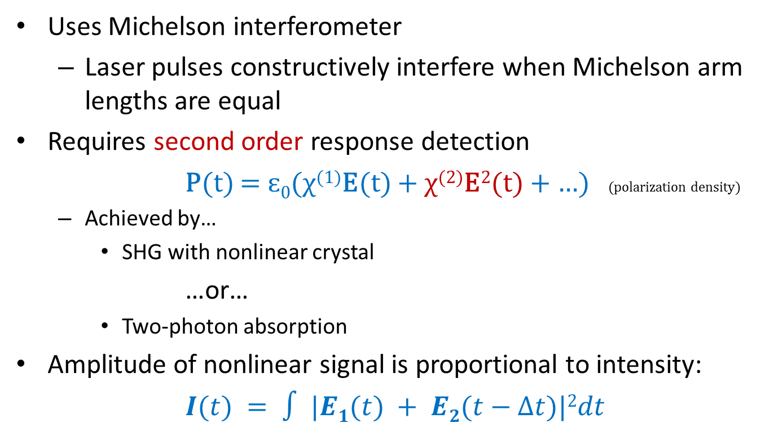
How it works…
Uses Michelson interferometer
  Laser pulses constructively interfere when Michelson arm lengths are equal
Requires second order response detection
  P(t) = ɛ₀(χ⁽¹⁾E(t) + χ⁽²⁾E²(t) + …) (polarization density)
  Achieved by…
    SHG with nonlinear crystal
  …or…
    Two-photon absorption
Amplitude of nonlinear signal is proportional to intensity:
  $I(t) = ∫ |E1(t) + E2(t−∆t)|2dt$

Slide 4
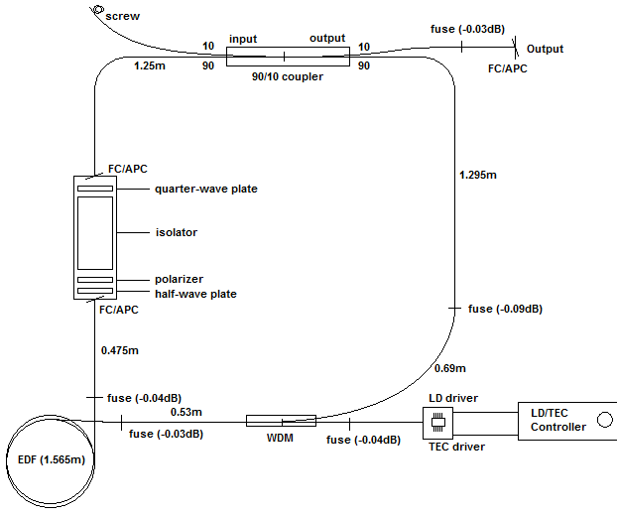
Pulsed Fiber Laser System
From Wesley Hughes and Jared Green’s Presentation

Slide 5
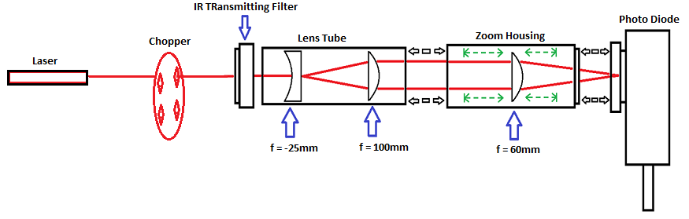
Signal Detection System
Observed Nonlinear Response of IR Fiber Laser:
  For Both Standard Silicon Diode (FDS100, ThorLabs) and Avalanche Photo Diode (AD500, Pacific Silicon Sensors)
  Requires small beam diameter on detector to increase probability of Two Photon Absorption
    d = λf/∏D D = Diameter of Beam d = diameter of focused spot size
    f = focal length
Also obtained the Gain Curves for :
  532nm Diode Laser, HeNe Laser, and IR Pulsed Fiber Laser

Slide 6
Gain of Avalanche Photo Diode
Gain = (APD Output) / (ADP Output at 1V)

Slide 7
APD Output vs Bias Voltage for Pulsed Fiber Laser
No signal below 90V Reversed Bias
No External Amplification on APD (yet)

Slide 8
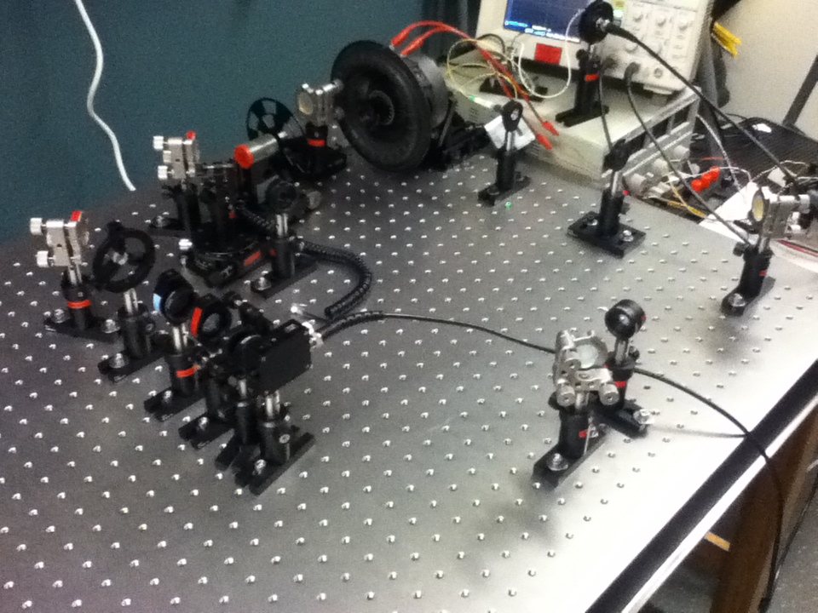


Interferometer Diagram and Picture
Beam Chopper included between Beam Splitter and Speaker
Top and Bottom Arm’s are chopped at different frequencies
Mirror
Mirror
Beam Splitter
Chopper
Speaker w/ Corner Cube
Concave Lens
Laser
Convex Lens’s
Mirror
Mirror
Mirrors and Lenses are maximized for IR

Slide 9
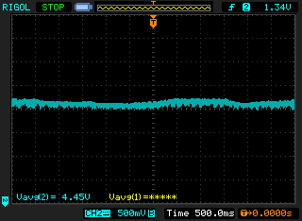
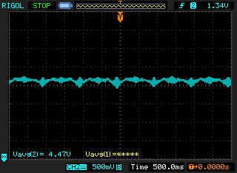
Data Acquisition
Linear Response measured with InGaAs Detector and Continuous Wave 1550nm IR Diode Laser
Speaker Off Speaker On (1 Hz)

Slide 10
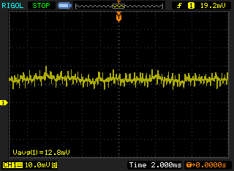
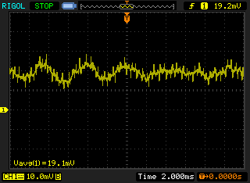
Nonlinear Response!
Nonlinear Response from 1550 nm IR Erbium Doped Pulsed Fiber Laser
Beam Passed through Interferometer then Focused onto Avalanche Photo Diode (APD)
  Gain: G ≈ 25 internal to APD at 135V, plus external gain from LT1028 op-amp
  Beam Blocked Beam Unblocked
Beam Blocked Beam Un-Blocked
Response Visible on APD Output (Lock-In Amp not able to Lock onto signal)

Slide 11
Future Investment
What can help to Complete Project:
InGaAs and Silicon (layered) Detector
  Allows Observation of Linear & Nonlinear Response Simultaneously (for easier signal capture/maximization)
Automatic single-axis translational stage for one Michelson arm
  Because human arms get tired
XYZ translation mount for Detector
  For Signal Optimization
More Powerful Laser

Slide 12
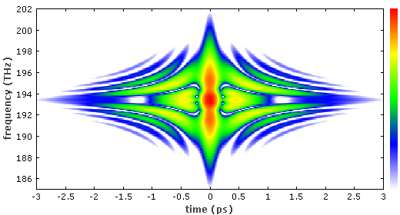
New techniques for laser pulse measurement:
FROG – Frequency Resolved Optical Gating
  Similar to autocorrelation, but gets more info
    Asymmetries resolved (chirp, satellite pulses)
    FROG trace:
SPIDER – Spectral Phase Interferometry for Direct Electric field Reconstruction
  Uses spectral shearing
  Both techniques require a spectrometer and special software.
  (Other “swamp” techniques: BOA Compression, SEA TADPOLE, MIIPS, and more…)

Slide 13
This is The End……

