Slide 1
Spontaneous Parametric Downconversion
Jacob Magers
with Matt Wilson in Part III

Slide 2
Part I: Spontaneous Parametric Downconversion
A process used to create single photons
Useful for testing conservation of energy and momentum, as well as seeing quantum behavior of light

Slide 3
How It Works
Photon enters BBO crystal with angular frequency ω_{p}, and momentum k_{p}
Two photons with angular frequencies ω_{i} and ω_{s}, and momenta k_{i} and k_{s} are emitted

Slide 4
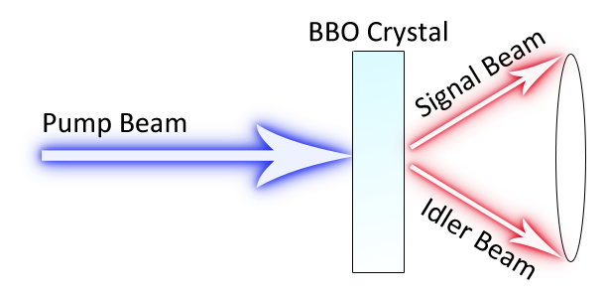
A Qualitative Illustration of
Type I Downconversion

Slide 5
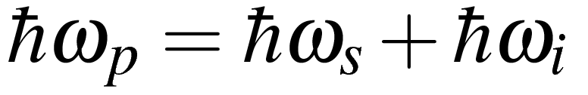

Conservation of Energy
Pump beam: λ = 406nm
Signal, Idler beams: λ ~ 812 nm

Slide 6
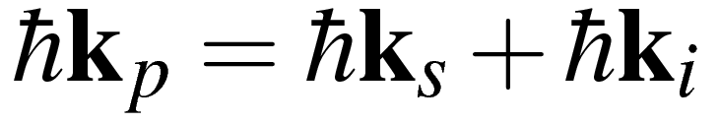
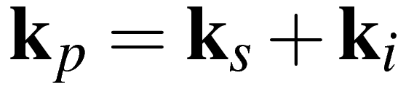
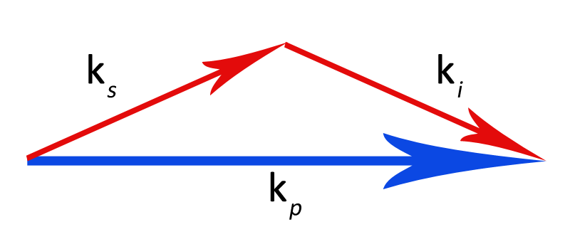
Conservation of Momentum

Slide 7
Experimental Goals
Achieve spontaneous parametric downconversion
Find out which angle with respect to pump beam maximizes counts
Observe conservation of momentum

Slide 8
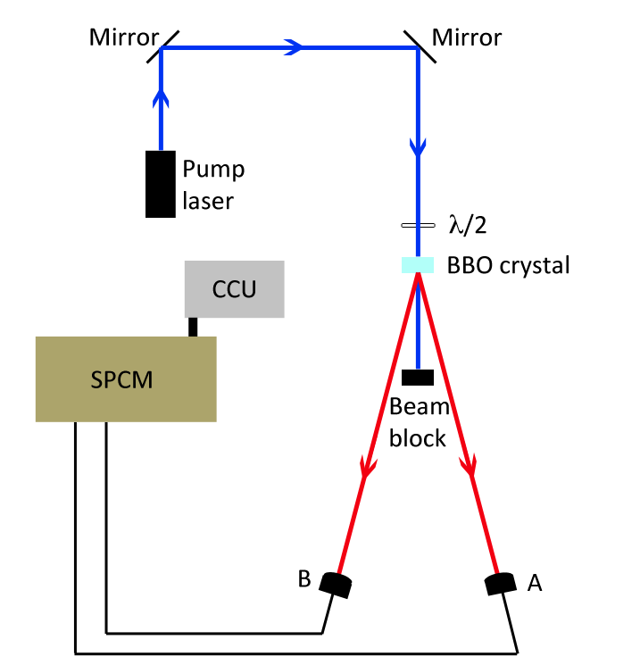
Experimental Apparatus

Slide 9
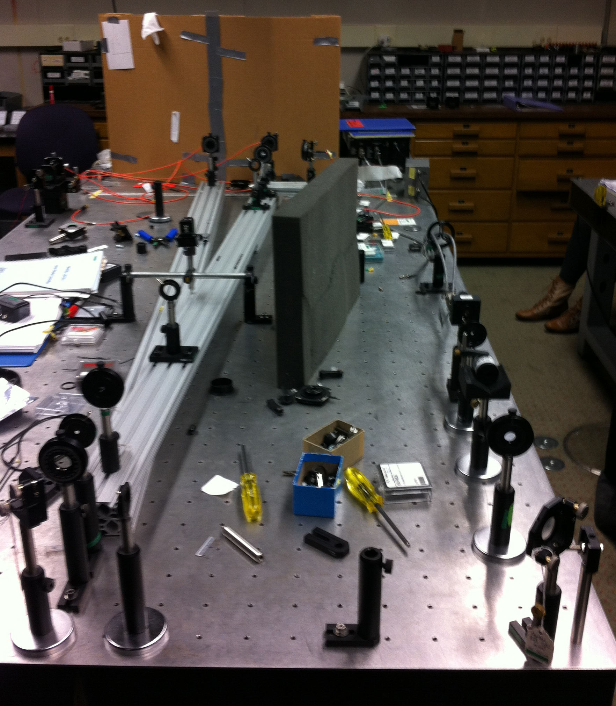
Experimental Apparatus

Slide 10
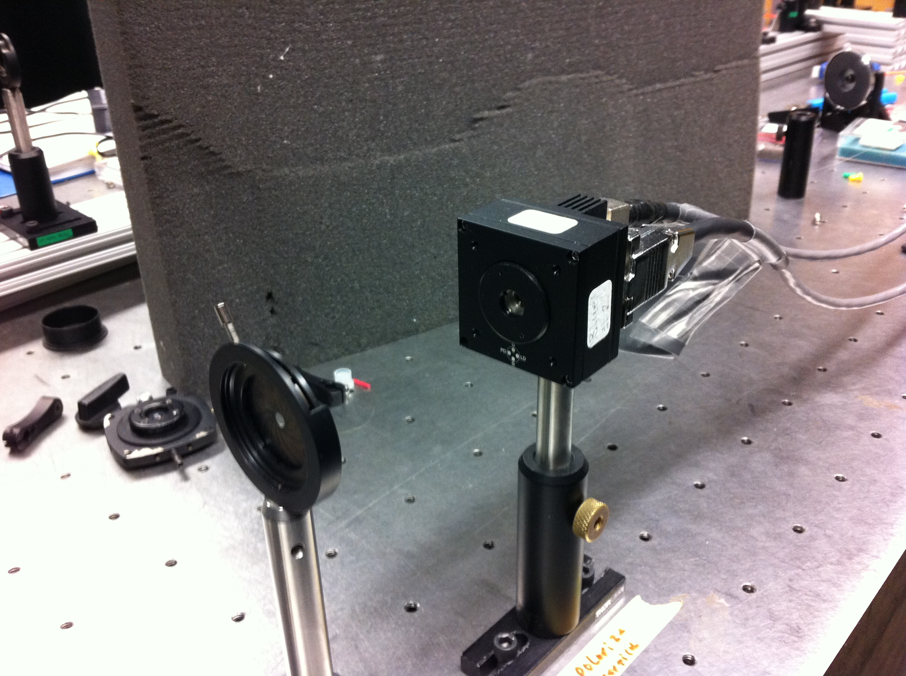
Pump Laser

Slide 11
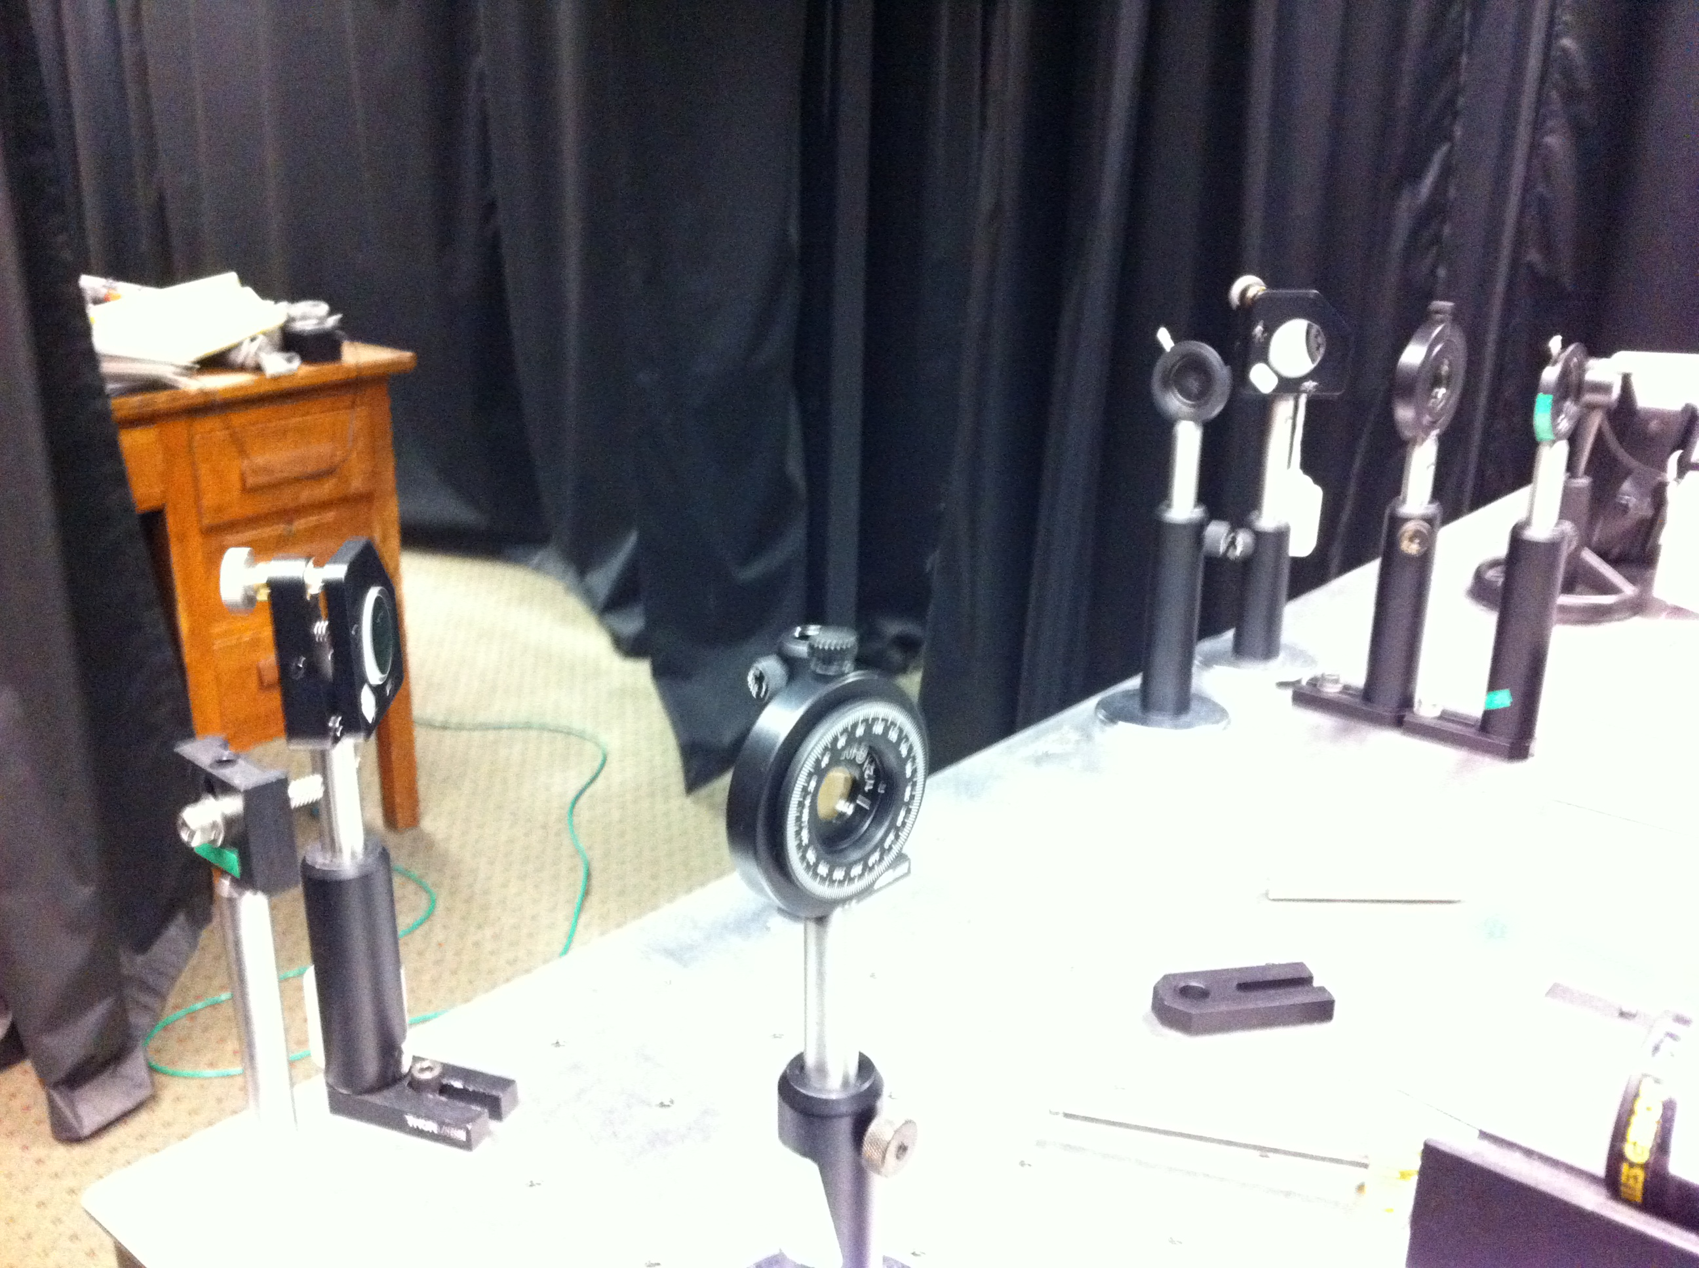
Mirrors and Apertures

Slide 12
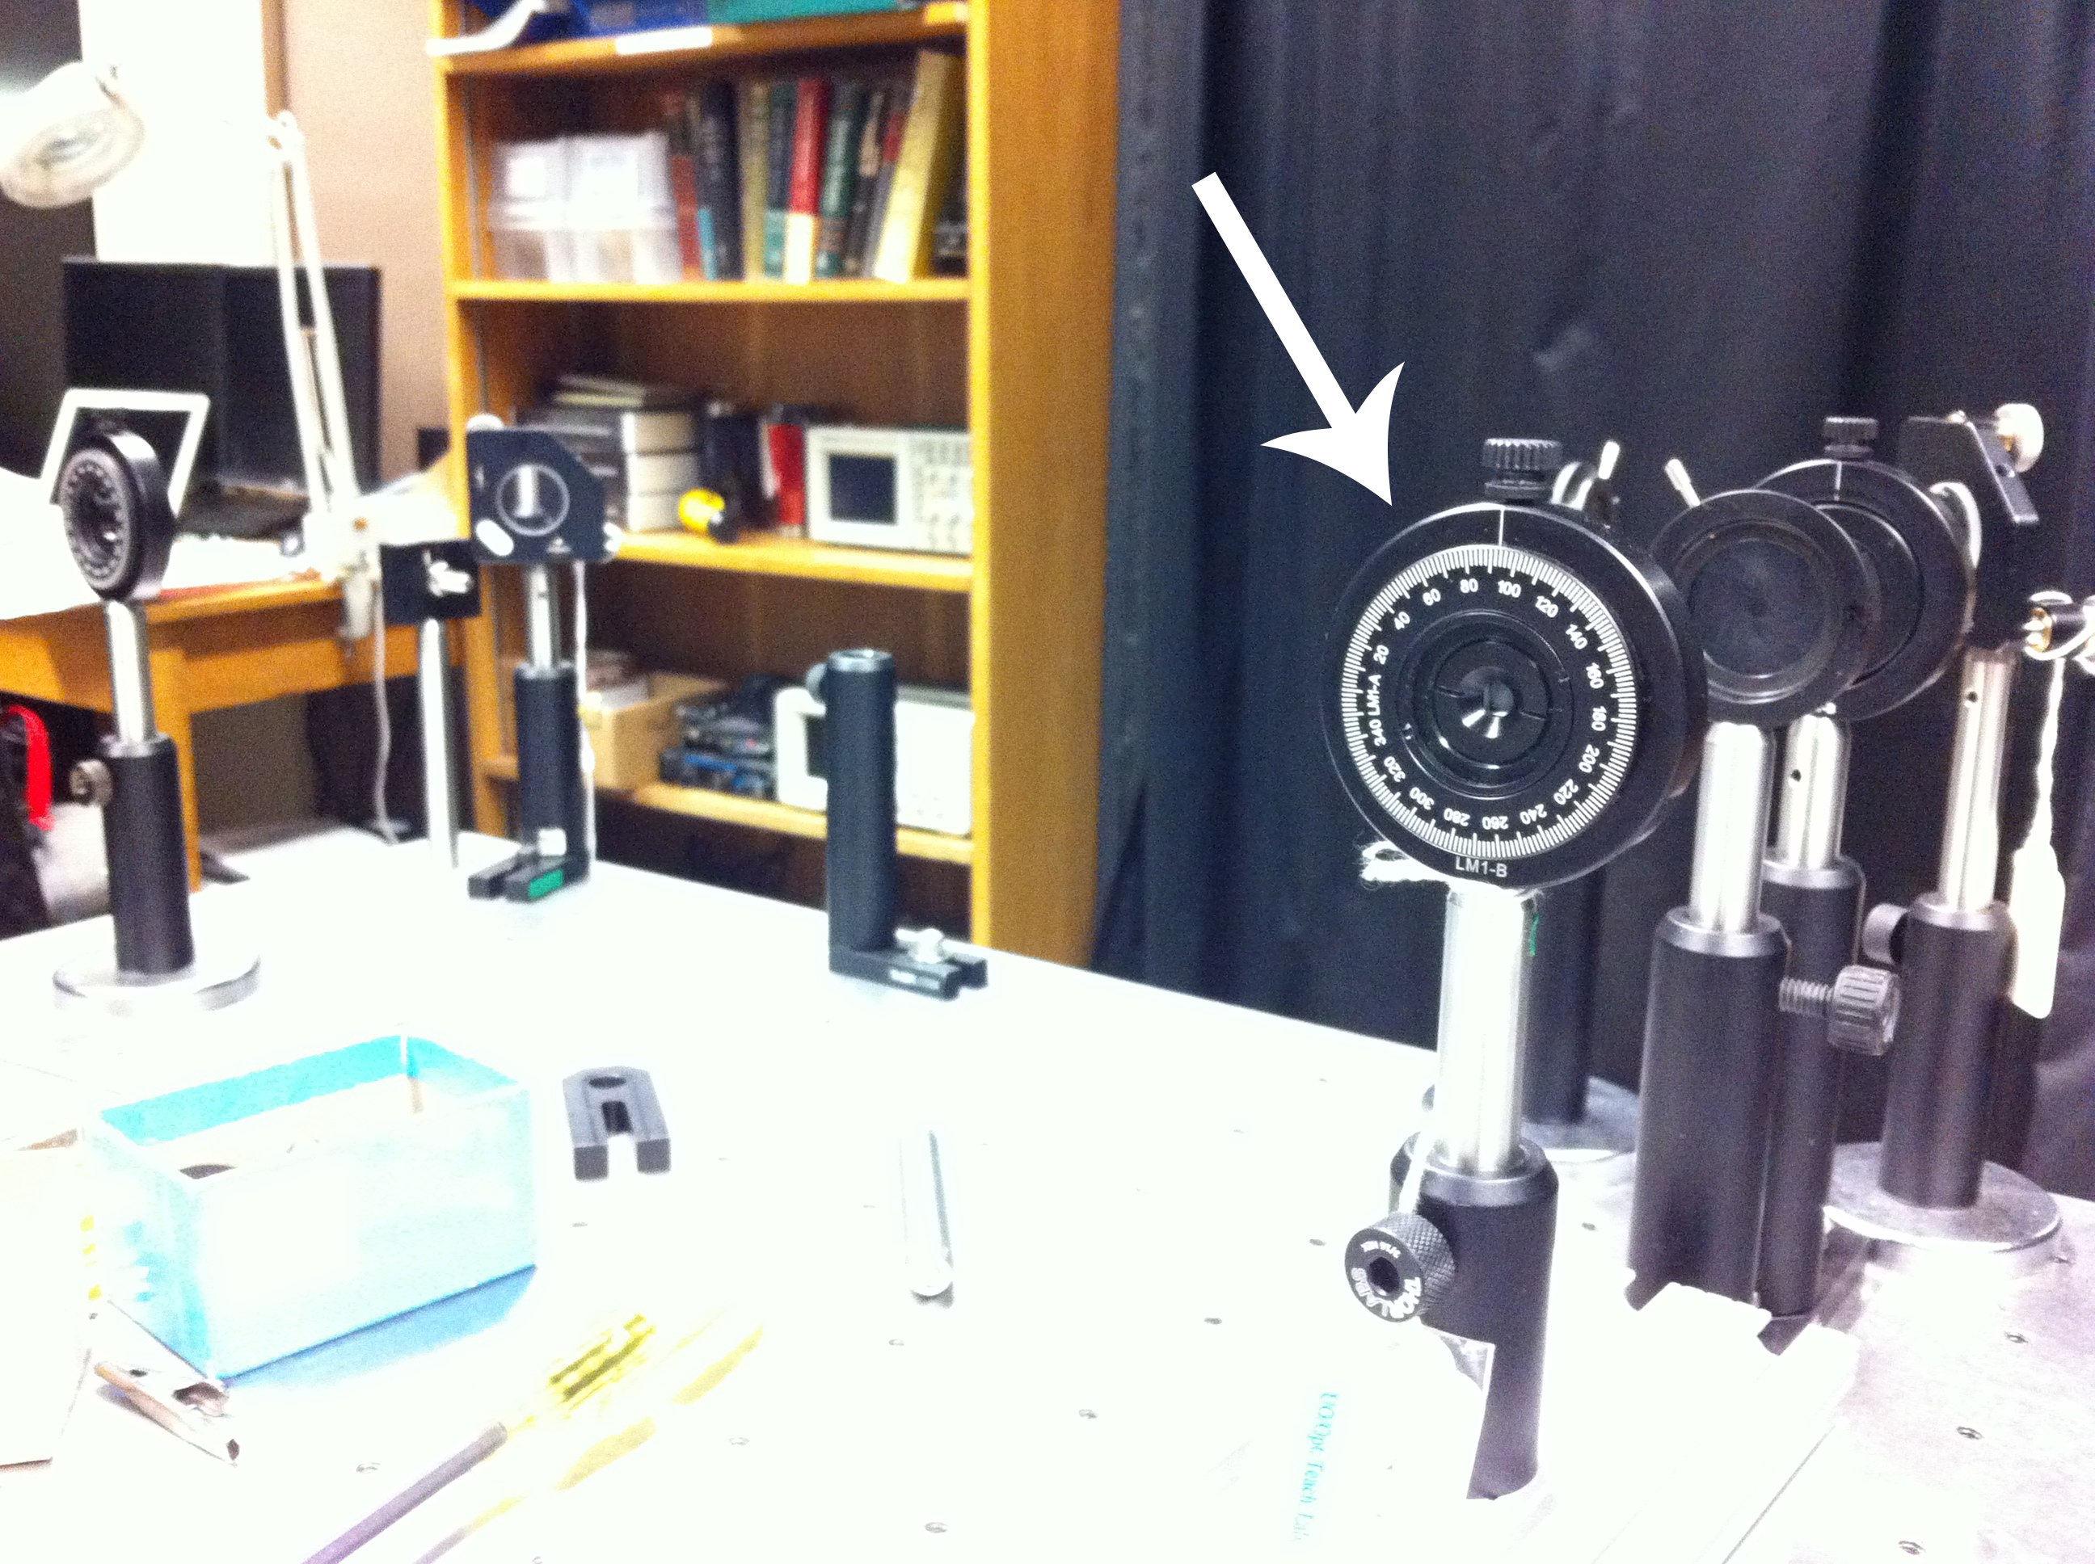
β-Barium Borate Crystal

Slide 13
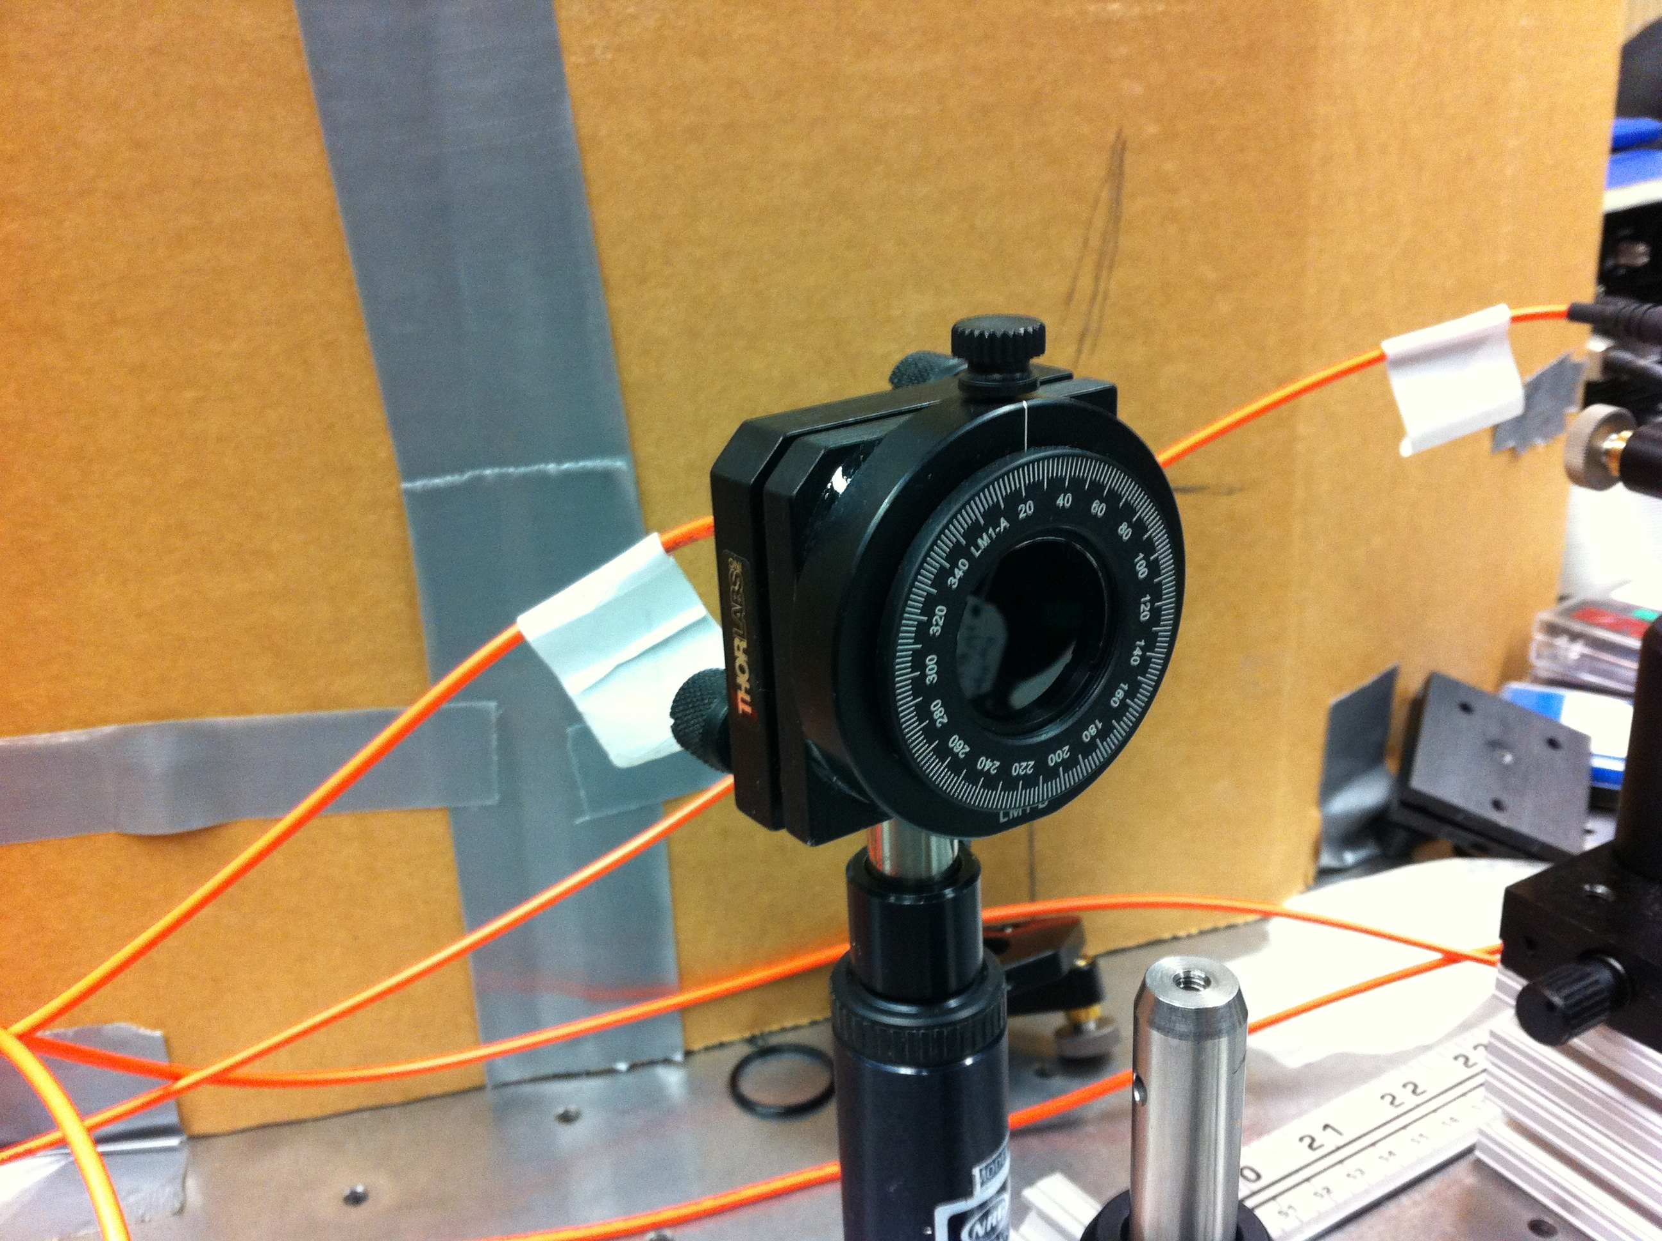
Detector A

Slide 14
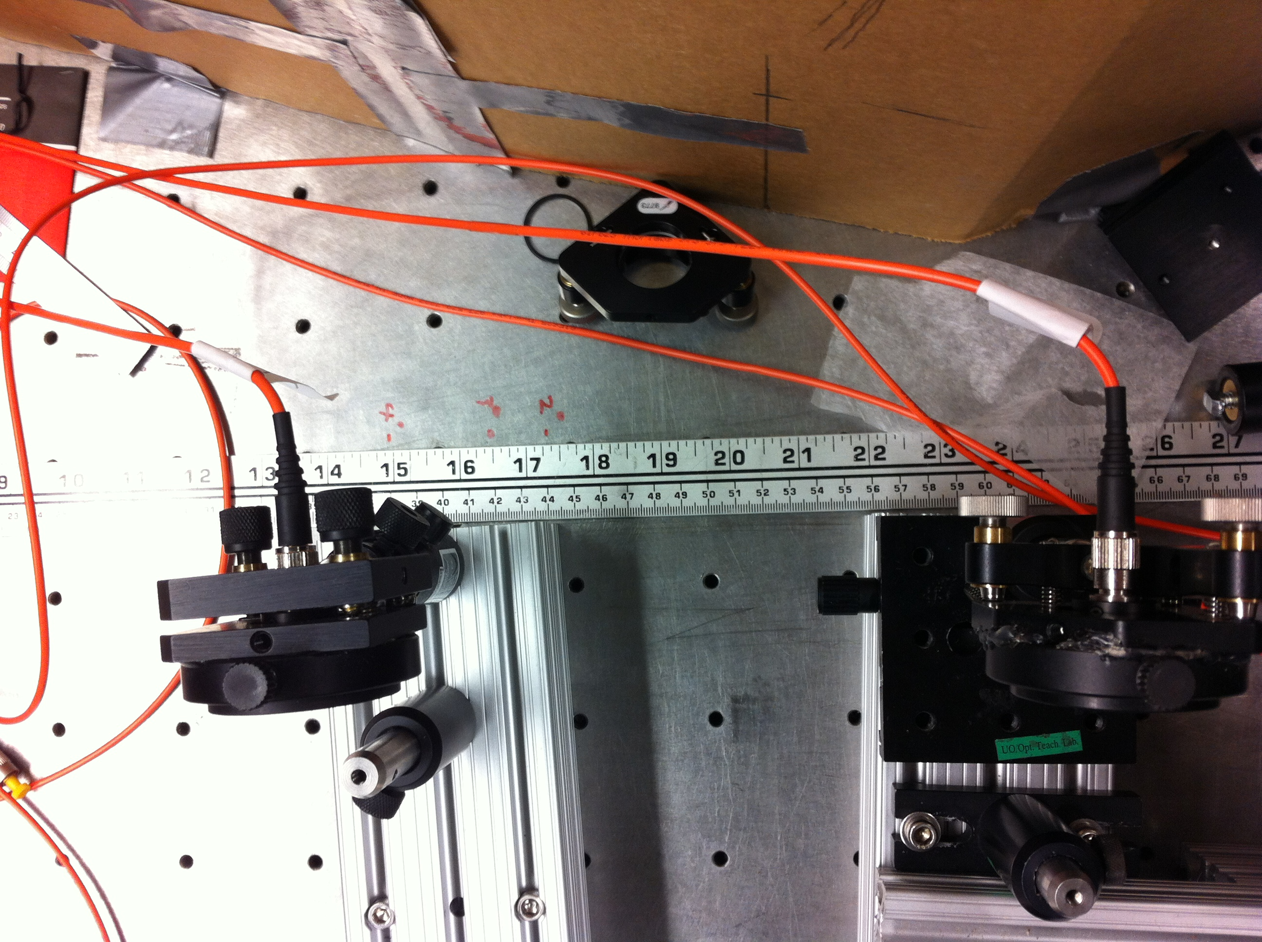
Detectors A and B

Slide 15
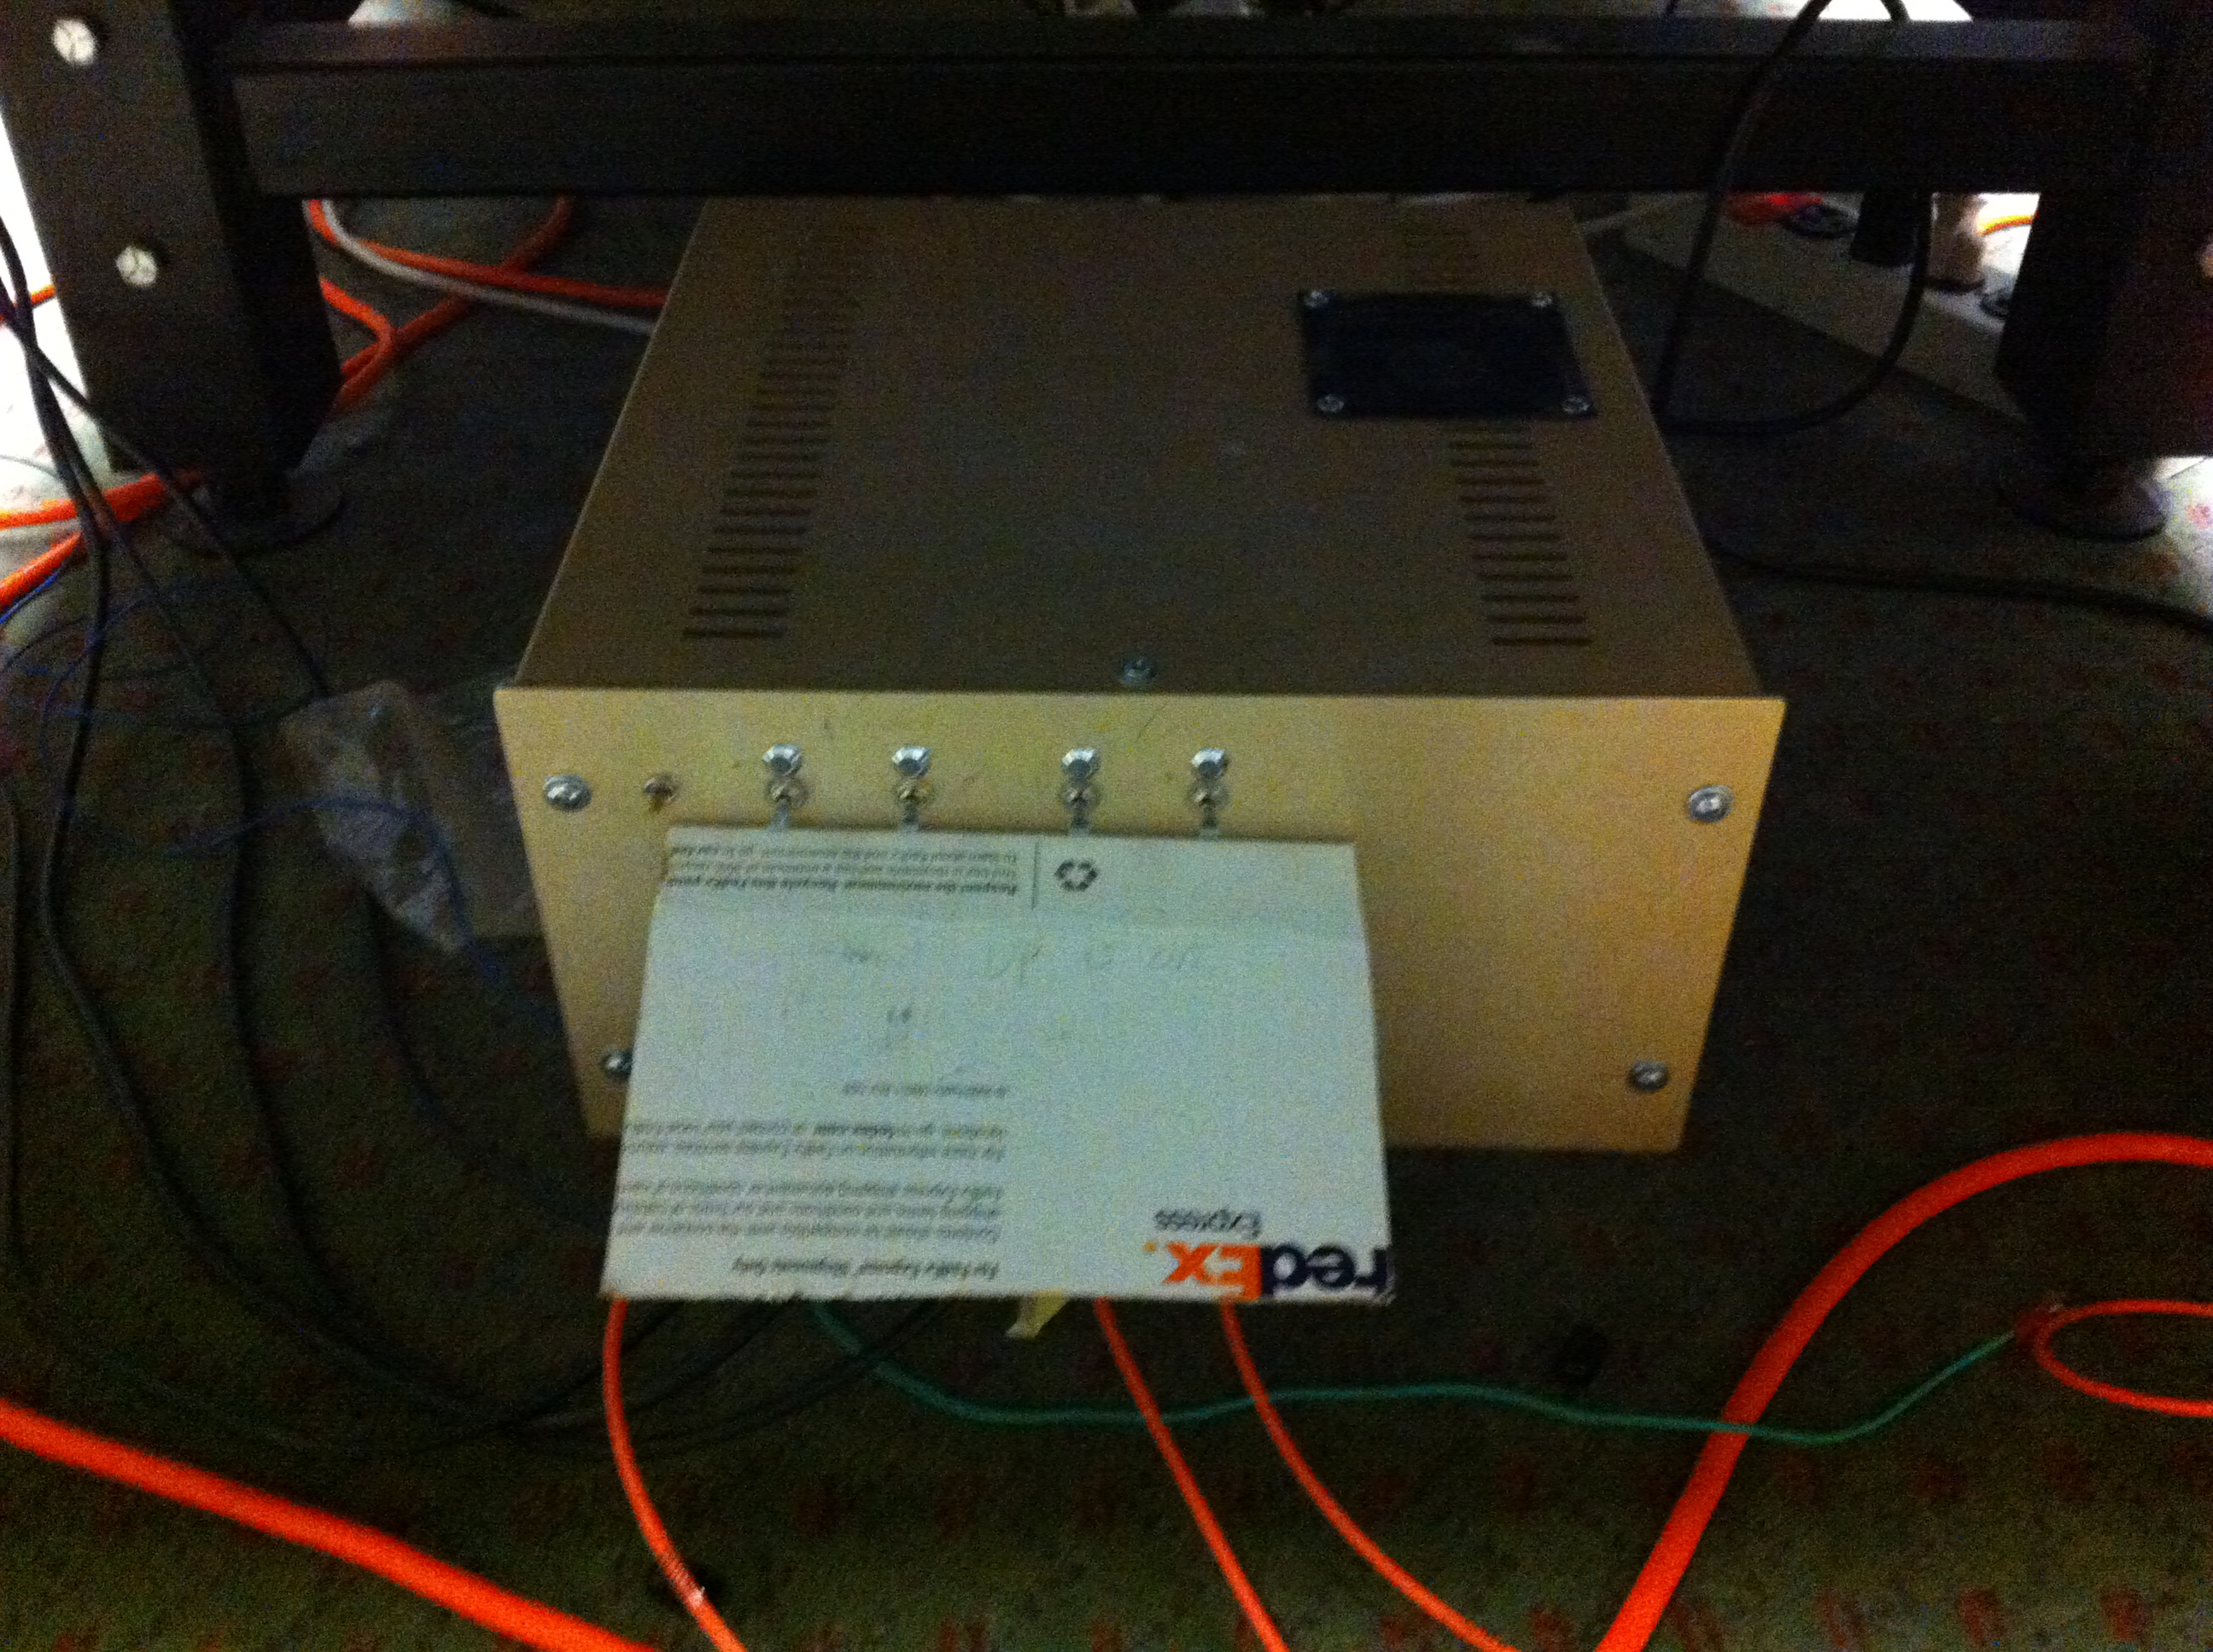
Single-Photon Counting Modules

Slide 16
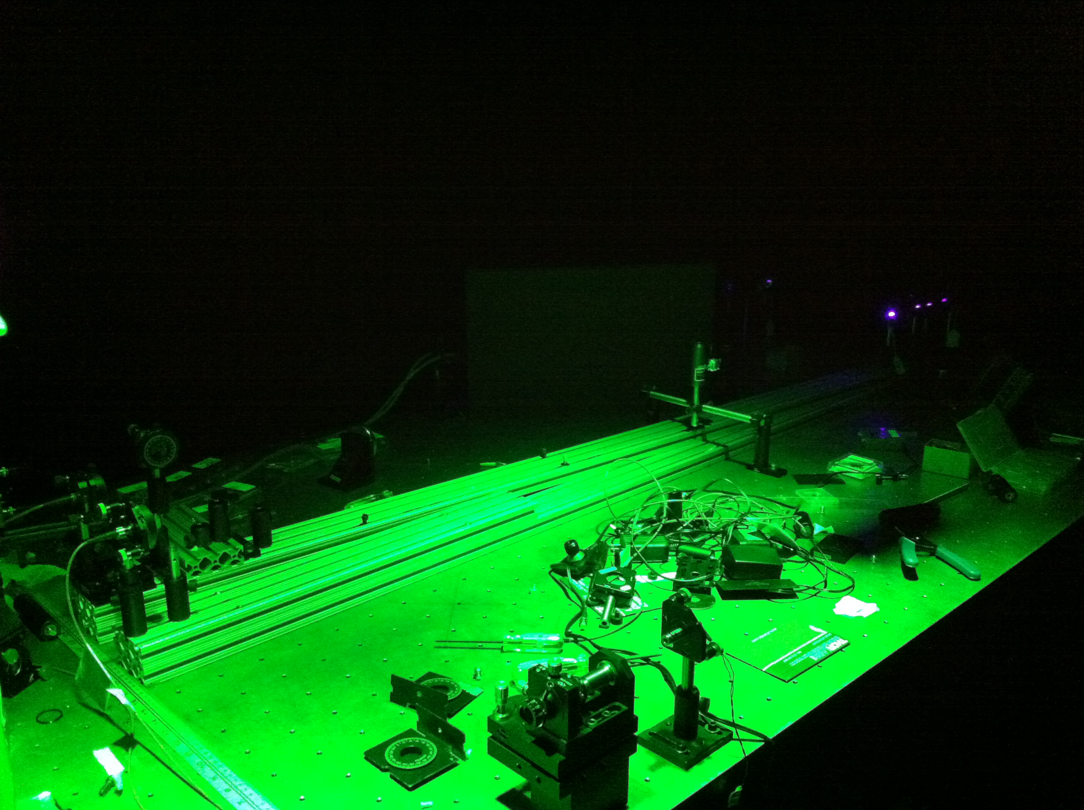
Safety Lights

Slide 17
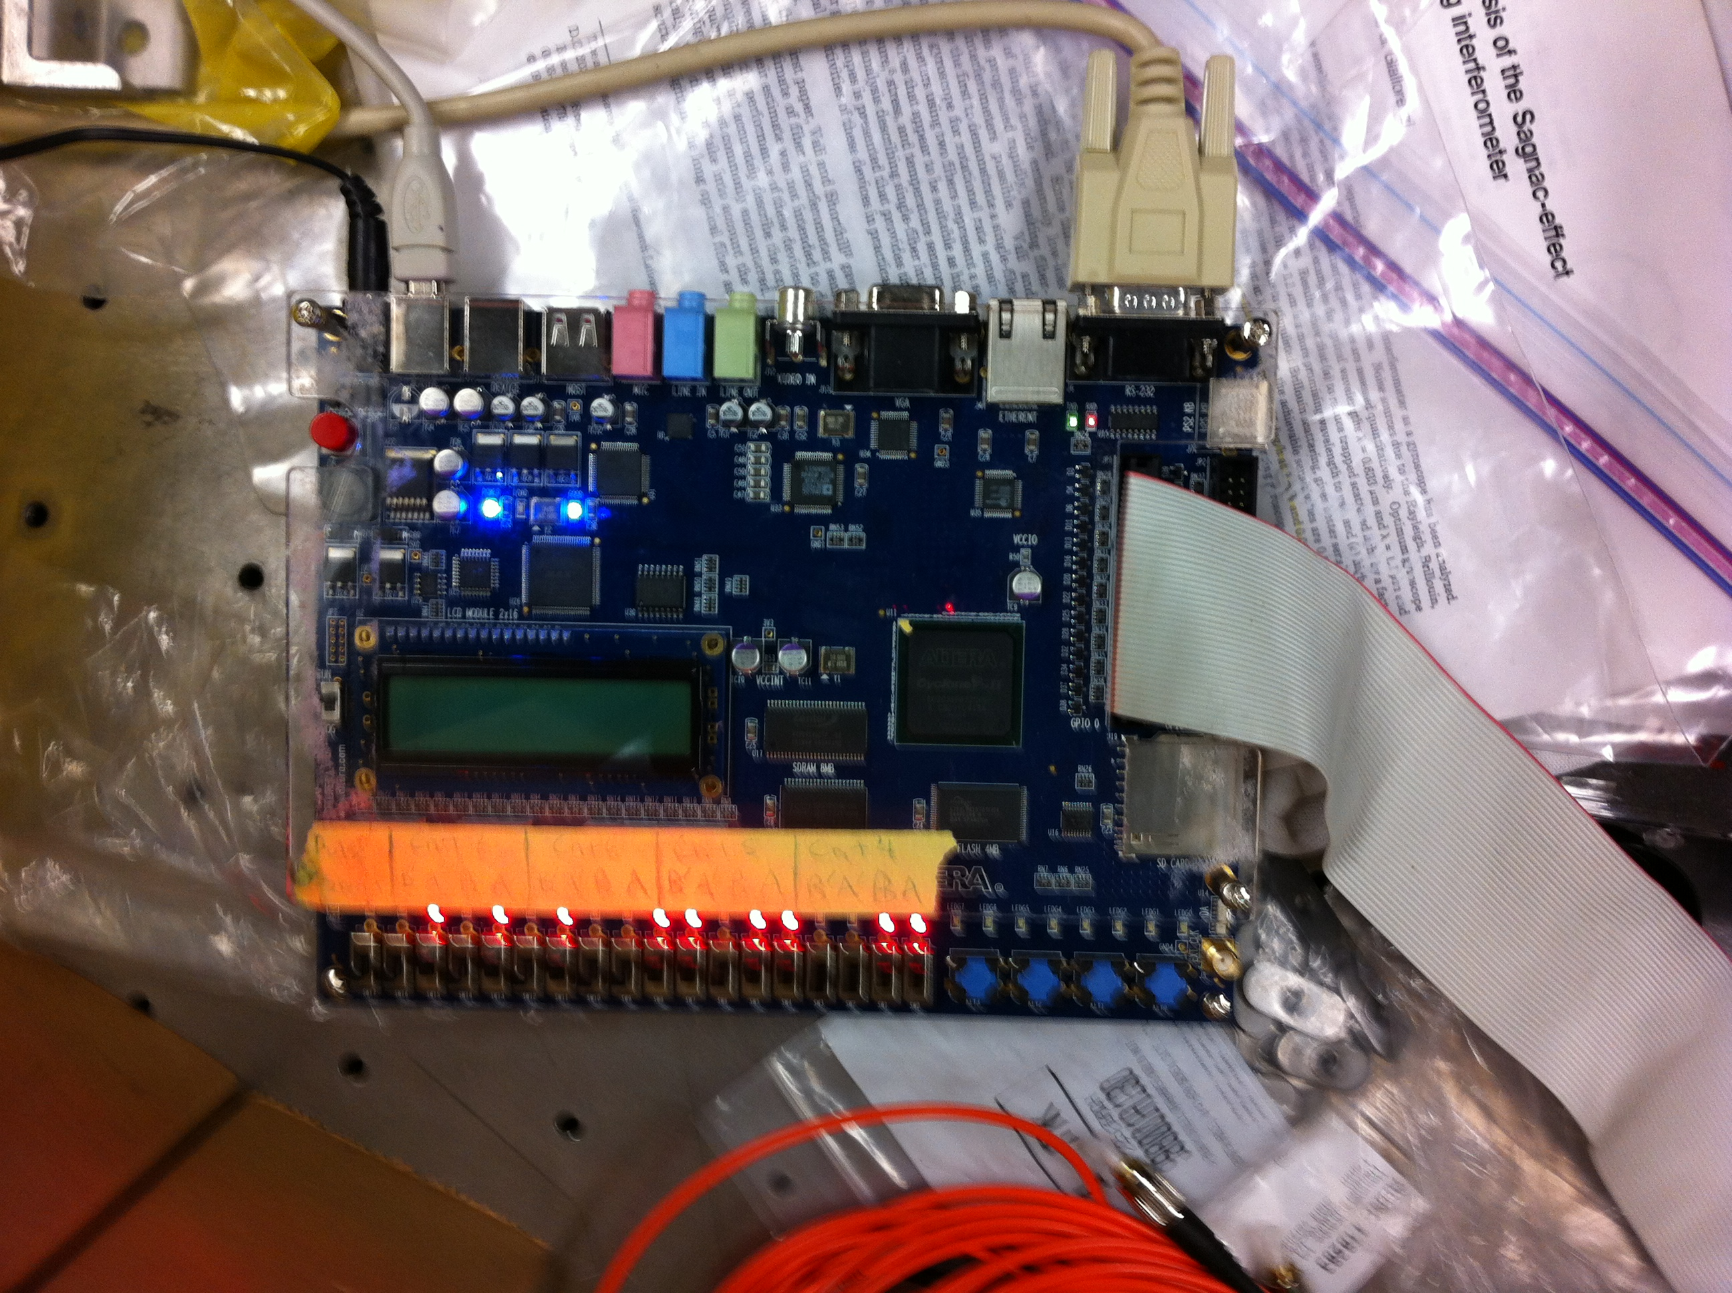
Coincidence Counting Unit

Slide 18
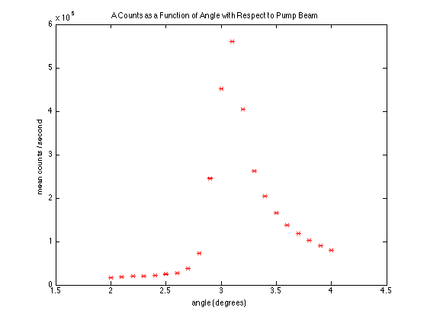
Comment: The error bars are for the y-axis, not the x-axis. The errors just so small that it looks like the other way around.
Notes:
The error bars are for the y-axis, not the x-axis. They’re just so small that it looks like the other way around.

Slide 19
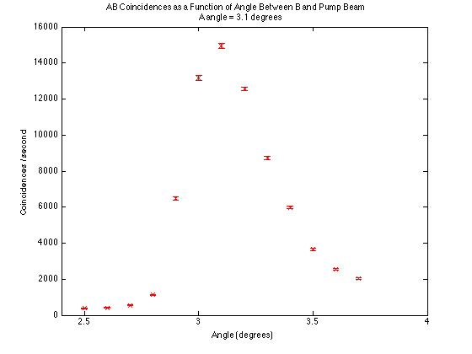

Slide 20
Results
Counts were maximized when the detector A made a 3.1º angle with respect to the pump beam
AB coincidences were maximized when detector B also made a 3.1º angle with respect to the pump beam

Slide 21
Part II: Degree of Second-Order Coherence g⁽²⁾(0)
Insert a polarizing beam splitter into one of the downconverted beams
A classical field can be transmitted and reflected simultaneously
A quantum field (consisting of single photons) can be transmitted OR reflected, not both

Slide 22
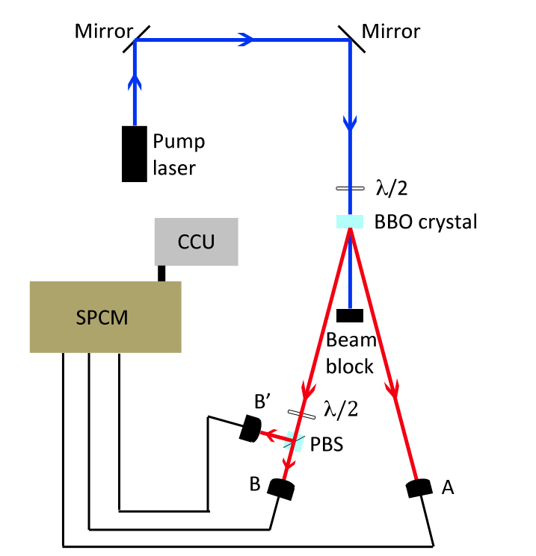
Experimental Apparatus

Slide 23
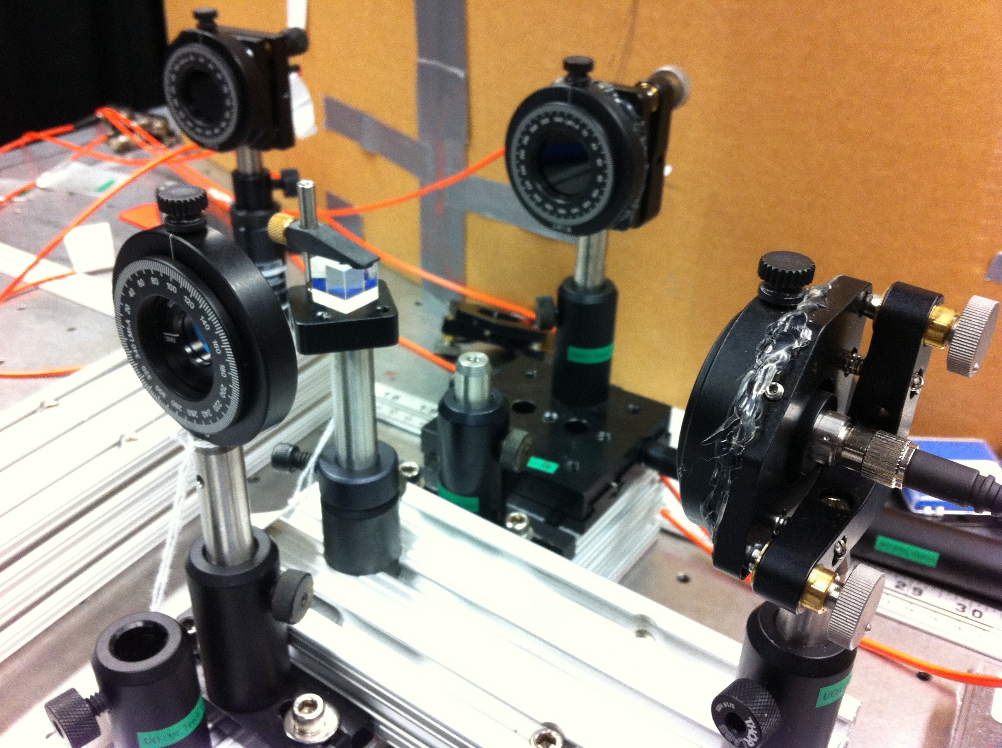
Three Detector Setup with PBS

Slide 24
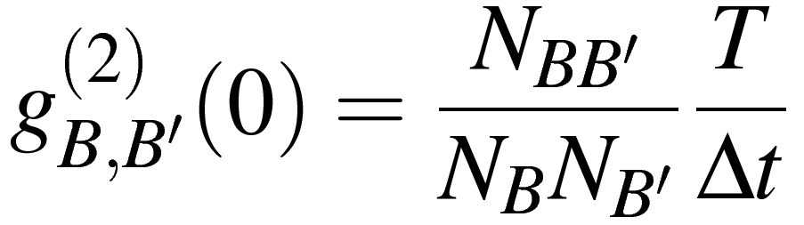
Two Detector g⁽²⁾(0)
T is the counting interval (2 to 10 seconds)
Δt is the coincidence time window (7.39 nanoseconds)
N_{B} and N_{B’} are the numbers of single counts in time T
N_{BB’} is the number of coincidences in time T

Slide 25
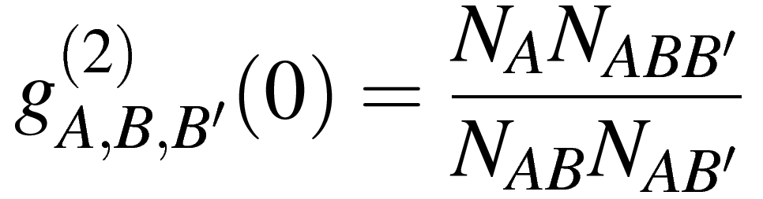
Three Detector g⁽²⁾(0)
N_{A} is the number of single counts on detector A
N_{ABB’}, N_{AB}, and N_{AB’} are coincidence counts

Slide 26
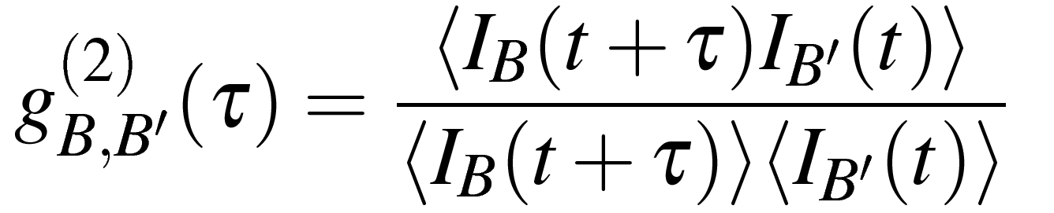
Derivation of g⁽²⁾(0)
(1)
I_{B}(t), I_{B’}(t) are the intensities of fields transmitted and reflected to detectors B and B’
τ is the time delay between intensity measurements

Slide 27
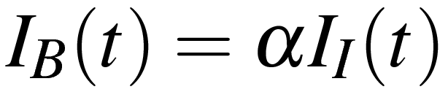
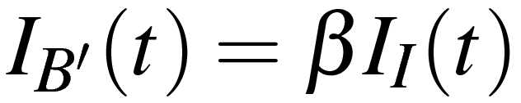
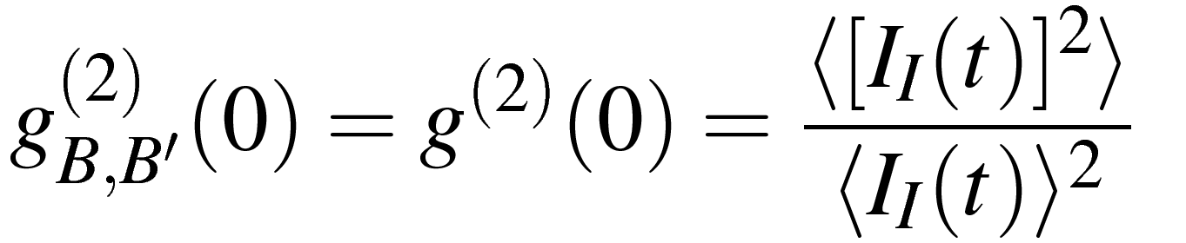
(2)
I_{I} is the intensity of the field incident on the beam splitter
α and β are the transmission and reflection coefficients, respectively
Substituting into (1) and cancelling coefficients:
(3)

Slide 28
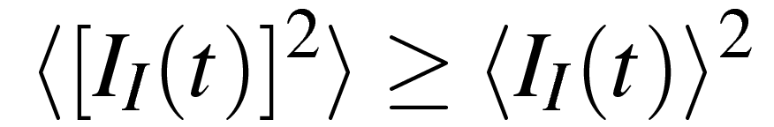
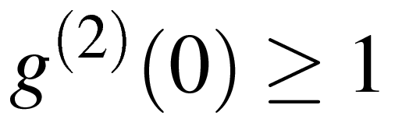
From the Cauchy-Schwartz inequality:
(4)
Therefore, for classical fields:
(5)

Slide 29
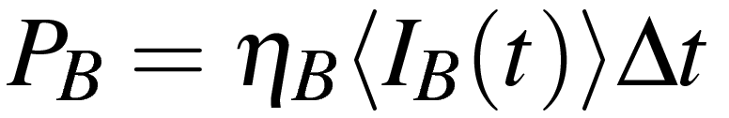
Relating Intensity to Photocurrent
(6)
P_{B} is the probability of obtaining a single photocount in time interval Δt
η_{B} is a constant of efficiency for detector B
(7)
P_{BB’}(τ) is the joint probability of obtaining a photocount on B and a
photocount on B’ after time τ
Notes:
Experimentally, we don’t measure intensity, but rather a number of photocounts in some time interval.

Slide 30
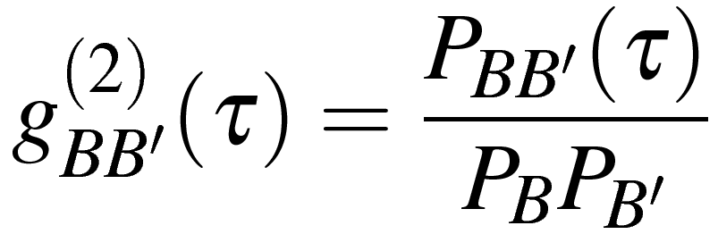
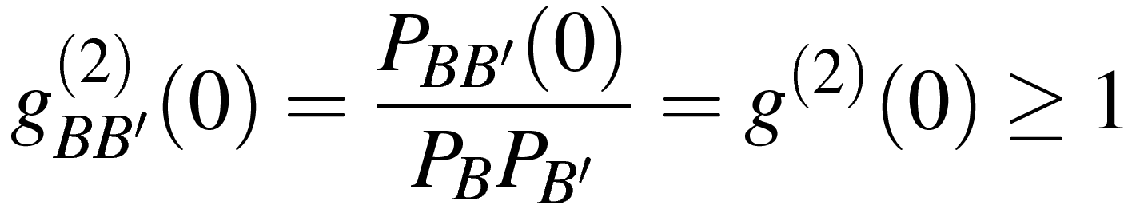
Substituting into (1) gives us:
(8)
Setting τ = 0, and remembering (5) gives us:
(9)

Slide 31
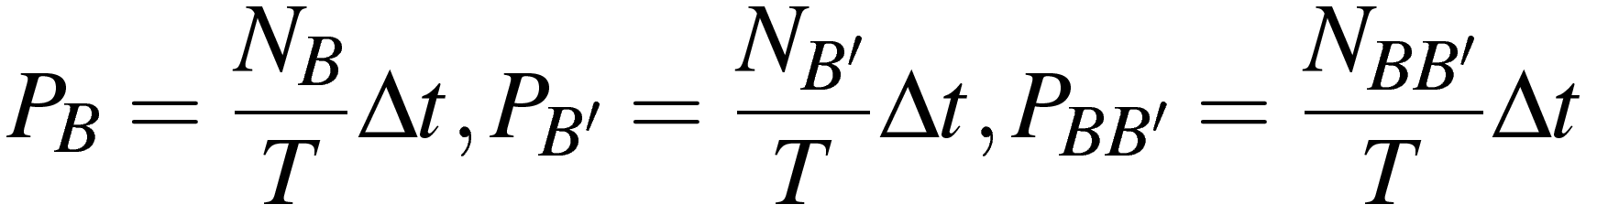
Probabilities in Terms of Counts
(10)
N_{B} is the number of counts on detector B in time interval Δt
T is the total time we are measuring over
Substituting into (9):
(11)

Slide 32
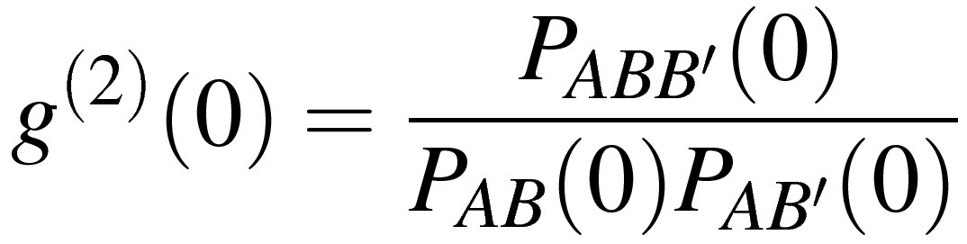
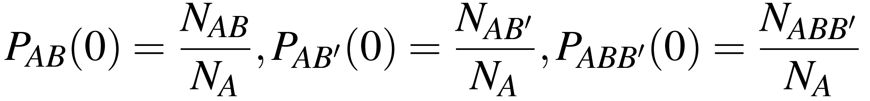
3 Detector g⁽²⁾(0)
When conditioning g⁽²⁾(0) on A counts:
(12)
Instead of normalizing over T, we take N_{A} to be our total number
of trials, so:
(13)

Slide 33
Substituting into (12) gives us:
(14)

Slide 34
Classical g⁽²⁾(0) vs Quantum g⁽²⁾(0)
Two detector measurements detect a classical field
Three detector measurements, conditioned on A counts, detect a quantum field
Classical result: g⁽²⁾(0) ≥ 1
Quantum Result: g⁽²⁾(0) < 1

Slide 35
Experimental Goals
Measure g⁽²⁾(0) ≥ 1 for 2 detector measurements, indicating a classical field
Measure g⁽²⁾(0) < 1 for 3 detector measurements, indicating a quantum field

Slide 36
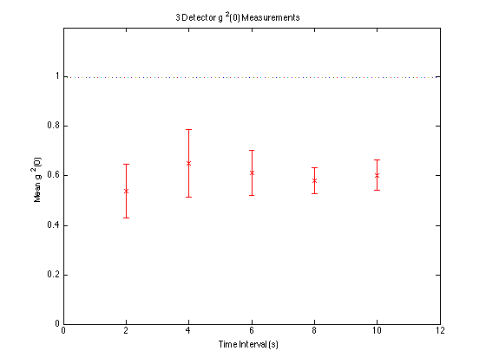

Slide 37
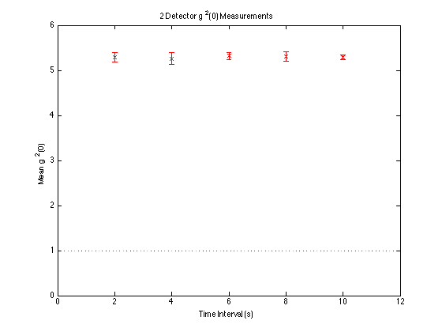

Slide 38
Results
3 detector measurements yielded g⁽²⁾(0) at least 2σ below 1, consistent with a quantum field
2 detector measurements yielded g⁽²⁾(0) >> 1, consistent with a classical field
Overall success

Slide 39
Part III: Single Photon Interference
Experimental goal: build a polarizing interferometer and observe single photon interference

Slide 40
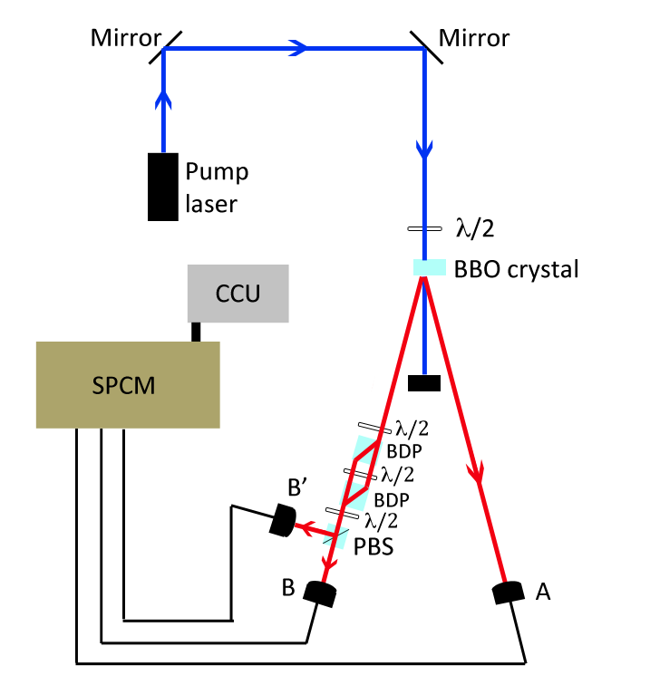
Polarizing Interferometer

Slide 41
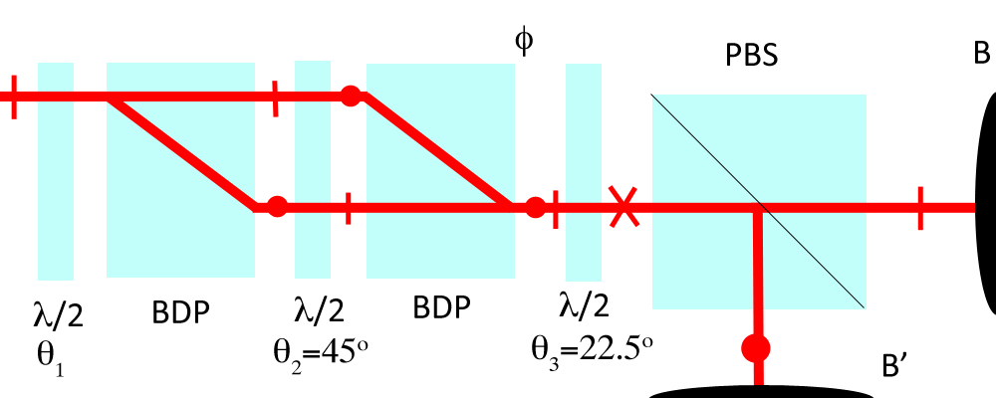
Polarizing Interferometer
Beam path is split and then recombined by the beam displacing polarizers

Slide 42
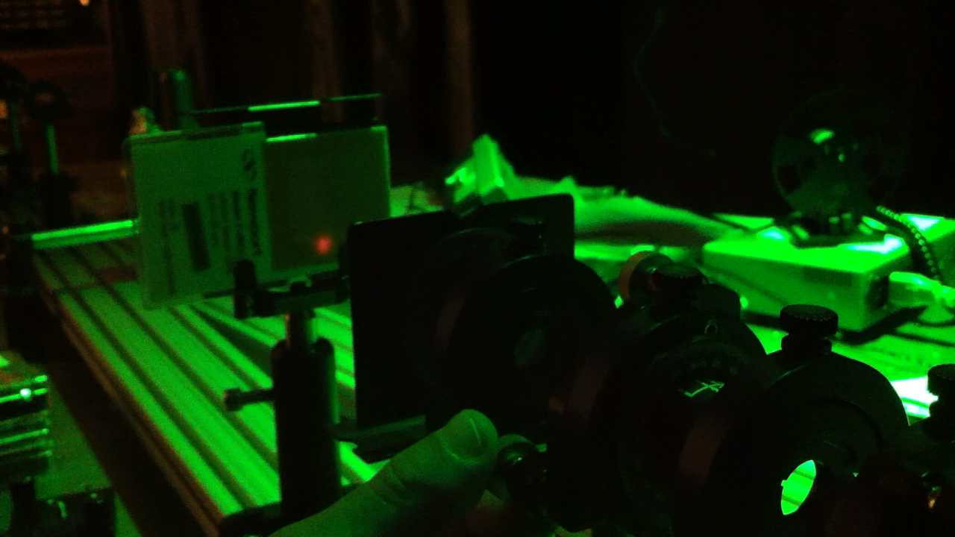
Interference Pattern with Alignment Laser
View in slideshow mode to see video of interference pattern

Slide 43
Single Photon Interference
If we see a sinusoidal pattern in B counts as we rotate the BDP, we are seeing an interference pattern
If g⁽²⁾(0) < 1 and we see the same sinusoidal pattern in AB coincidence counts, we are seeing single photon interference

Slide 44
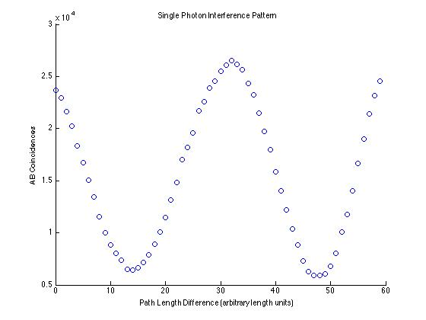
Integration time: 8 seconds Visibility: 0.63
Interference patterns near equal path lengths through the interferometer showed visibility of ~0.85

Slide 45
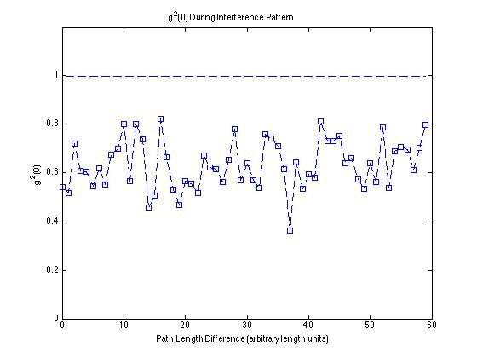
Mean: 0.63 Standard Deviation: 0.10

Slide 46
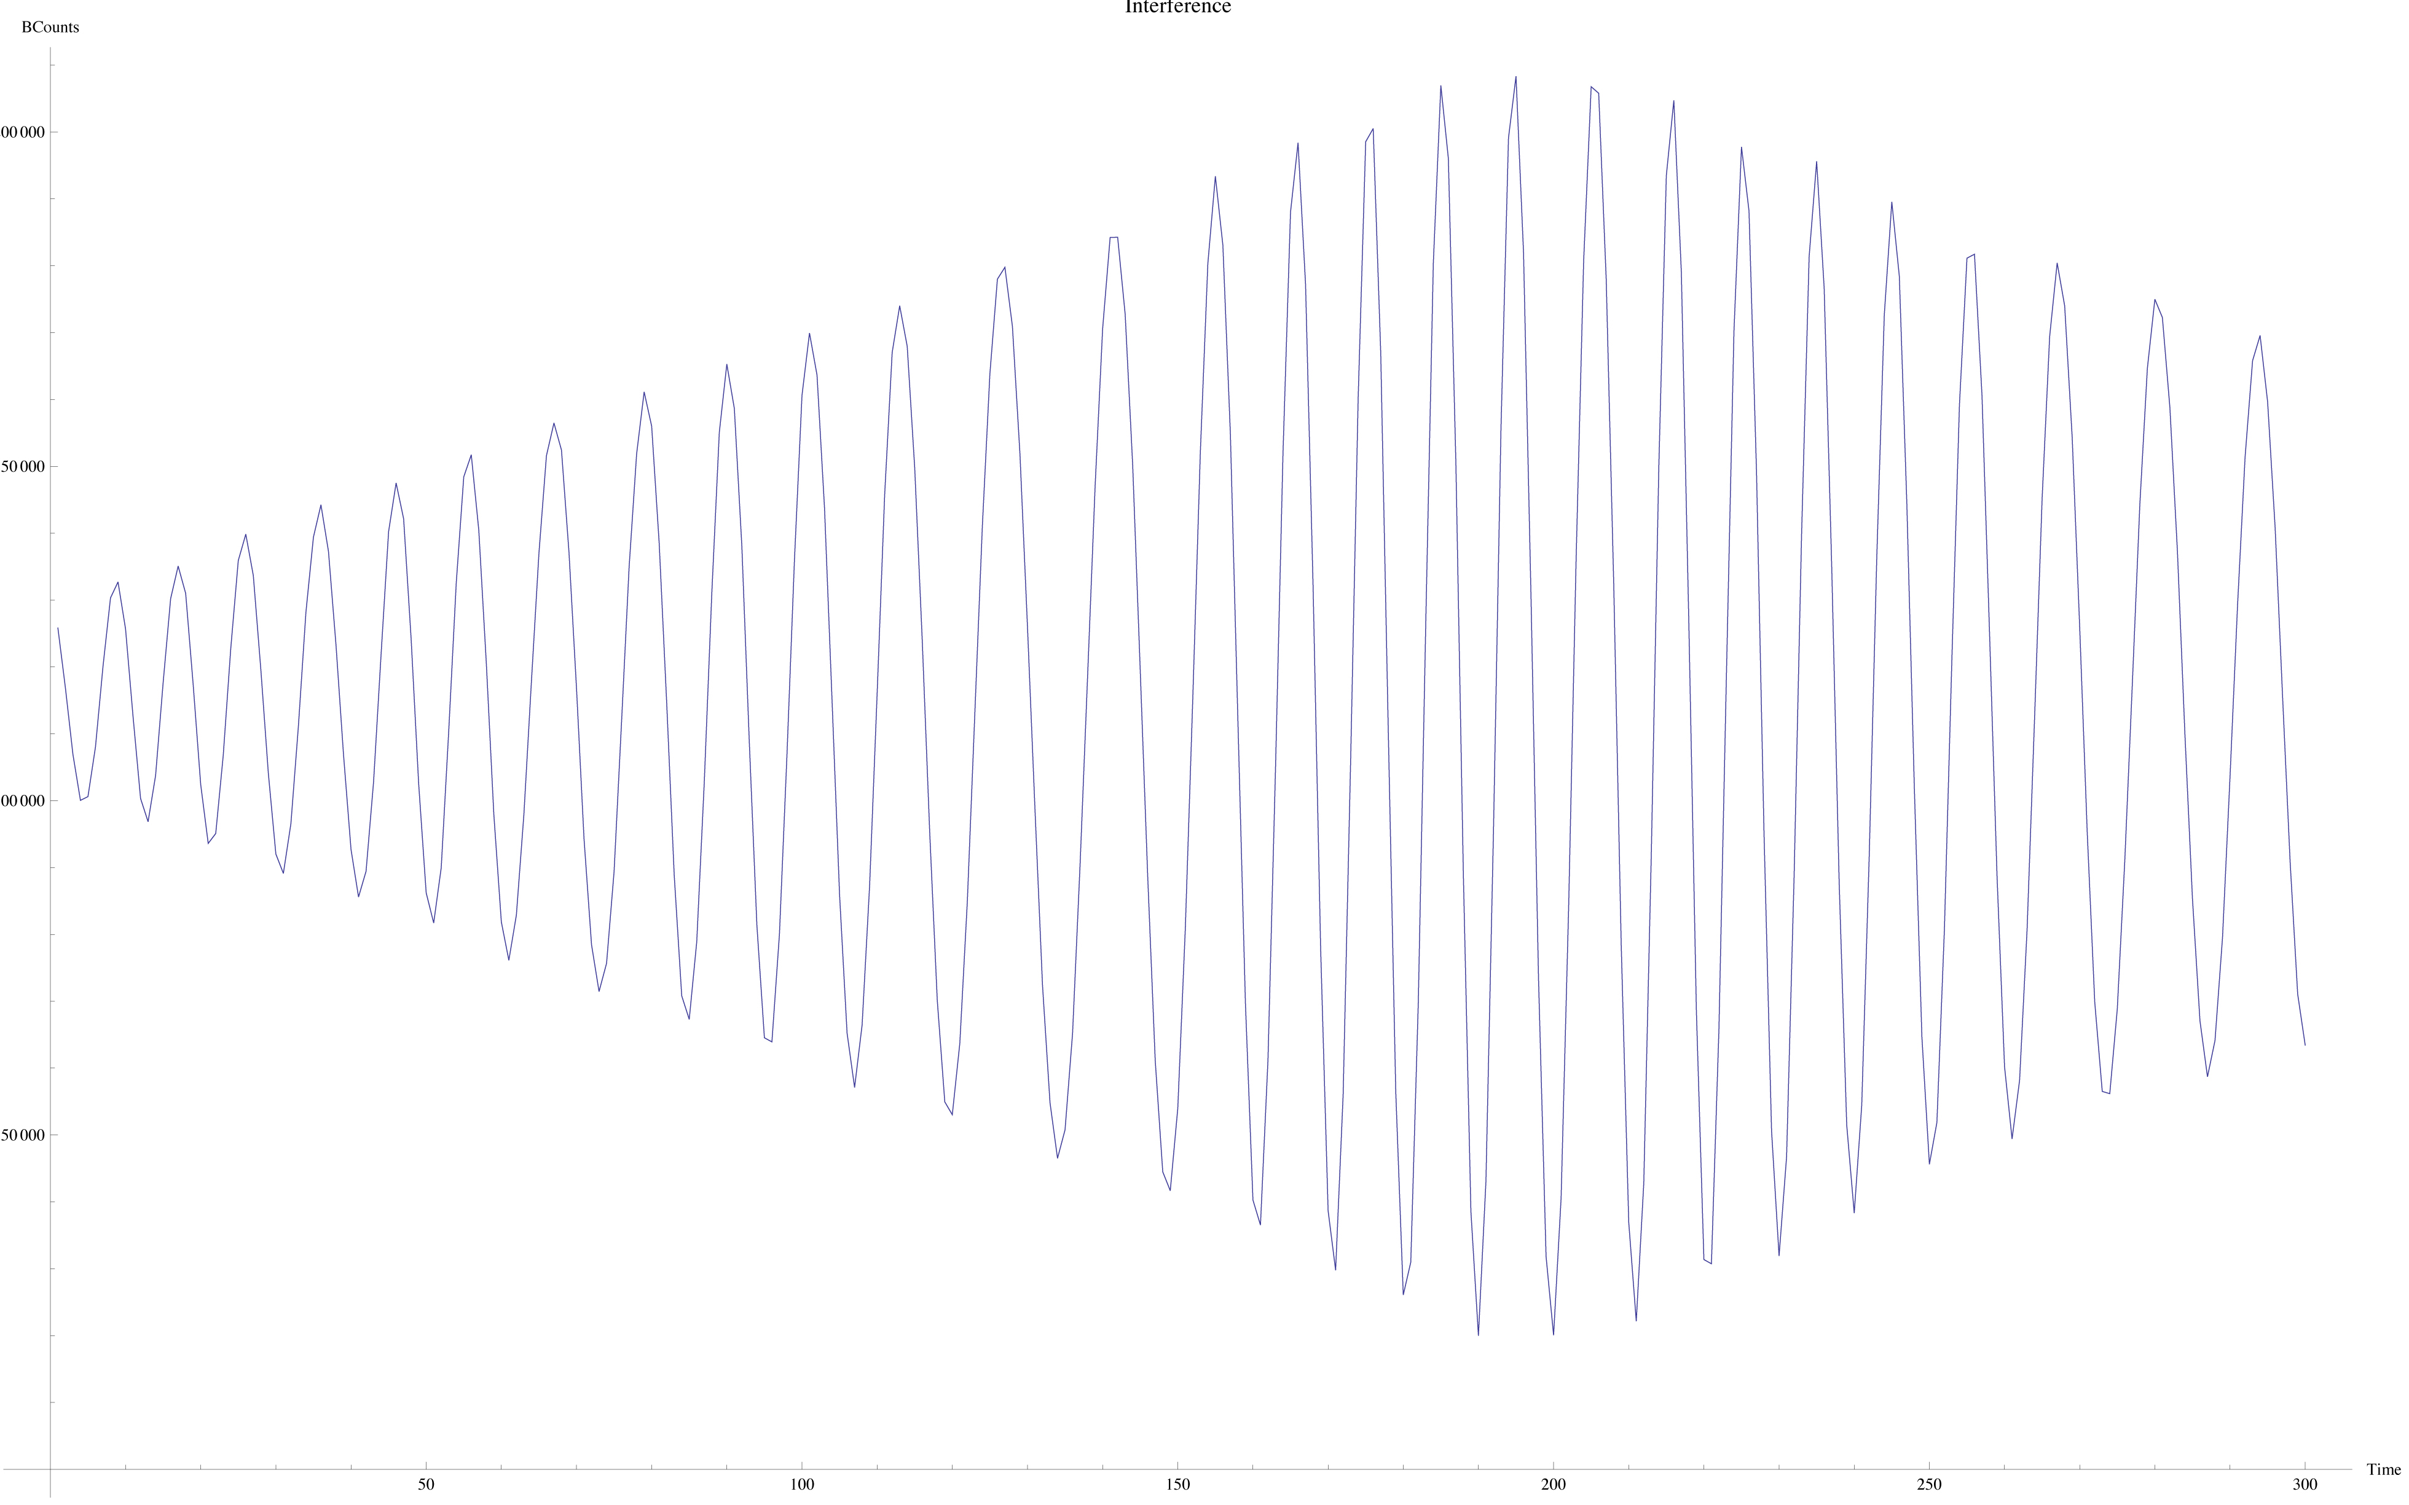
Nice view of where maximum visibility occurs

Slide 47
Results
An interference pattern was observed in the AB coincidence counts
This, combined with g²(0) measurements 3.7 standard deviations less than 1 (during the same data run) indicates that we successfully observed single photon interference
These three experiments show that light simultaneously exhibits wave and particle-like behavior

Slide 48
References
Beck, Mark. Quantum Mechanics: Theory and Experiment. New York: Oxford UP,
2012. Print.
Notes:
Beck, Mark. Quantum Mechanics: Theory and Experiment. New York: Oxford UP, 2012. 435-62. Print.

